Slide 1
Normalization REVIEW
DBS201

Slide 2
6 Types of Keys:
Composite Key
Natural Key (usually Composites)
Surrogate Key (AKA: Unnatural Key)
Candidate Key
Primary Key
Foreign Key

Slide 3
CLASSLIST
SubjectCode | Section | InstNo | InstName | SubjectName | StudentNo | StudentName
DBS201 | A | 122 | Russ Pangborn | Intro to DB | 111111111 222222222 | Terry Adams Jack Chan
DBS201 | B | 323 | Bill Gates | Intro to DB | 121212121 323233232 | Frank Brown Mary Wong
RPG544 | A | 122 | Russ Pangborn | RPGIV | 444444444 143211222 | Wendy Clark Peter Lind
UNF:
CLASSLIST [ SubjectCode, SectionCode, InstructorNo, InstructorName, SubjectName, {StudentNumber, StudentName} ]
A relation is in 1st normal form when the primary key determines a single value of each attribute for all attributes in the relation (i.e. the relation contains no repeating groups — no multiple dependencies).
There are two ways to get to 1NF . . .

Slide 4
CLASSLIST
SubjectCode | Section | InstNo | InstName | SubjectName | StudentNo | StudentName
DBS201 | A | 122 | Russ Pangborn | Intro to DB | 111111111 | Terry Adams
DBS201 | A | 122 | Russ Pangborn | Intro to DB | 222222222 | Jack Chan
DBS201 | B | 323 | Bill Gates | Intro to DB | 121212121 | Frank Brown
DBS201 | B | 323 | Bill Gates | Intro to DB | 323233232 | Mary Wong
RPG544 | A | 122 | Russ Pangborn | RPGIV | 444444444 | Wendy Clark
RPG544 | A | 122 | Russ Pangborn | RPGIV | 143211222 | Peter Lind
UNF:
CLASSLIST [ SubjectCode, SectionCode, InstructorNo, InstructorName, SubjectName, {StudentNumber, StudentName} ]
METHOD 1: Add to key of unnormalized relation to insure primary key identifies 1 and only 1 value of each attribute in the relation.
1NF:
a. CLASSLIST [ SubjectCode, SectionCode, InstructorNo, InstructorName, SubjectName, StudentNumber, StudentName ]
b.) CLASSLIST [ SubjectCode, SectionCode, StudentNumber, InstructorNo, InstructorName, SubjectName, StudentName ]

Slide 5
UNF:
CLASSLIST [ SubjectCode, SectionCode, InstructorNo, InstructorName, SubjectName, {StudentNumber, StudentName} ]
Method 2:
Restate the original un-normalized relation without the repeating group
And, create a new relation consisting of key of original relation and attributes within repeating group and add to key to ensure uniqueness
CLASSLIST [ SubjectCode, SectionCode, InstructorNo, InstructorName, SubjectName ]
CLASSLISTSTUDENT [ SubjectCode, SectionCode, StudentNumber, StudentName ]

Slide 6
Example: UNF to 1NF
DentistsOffice [OfficeNo, MailAddress, HeadDentist, (PatientNo, PatientName) ]
Select the Primary Key for the multi-valued dependency.
Create a two-part primary key by concatenating the original PK with the PK of the multi-valued dependency
DentistsOffice [OfficeNo, PatientNo MailAddress, HeadDentist, PatientName ]

Slide 7
DBDL
DataBase Design Language (Relational Notation)
Entity Set (3NF)

Slide 8
Dependencies
Functional Dependency (e.g., primary key → other attributes)
Multi-value Dependency
Remove for 1NF
Partial Dependency
Remove for 2NF
Transitive Dependency
Remove for 3NF

Slide 9
Multiple Multi-Value Dependencies
UNF: [key1, at2, at3, (key2, at4, at5), (key3, at6) ]
1NF: [key1, at2, at3] [key1, key2, at4, at5] [key1, key3, at6]
UNF: [key1, at2, at3, (key2, at4, (key5, at6) ) ]
1NF: [key1, at2, at3] [key1, key2, at4] [key1, key2, key5, at6]

Slide 10
More Than 1 Multi-valued Dependency Bridge Tables
Agenda:
1. Multiple multi-valued dependencies.
2. Bridge tables for Many-to-Many Relationships.

Slide 11
1. Multiple multi-valued dependencies
Here we are concerned about relations that have two or more multi-valued dependencies. Each dependency is separate. It is not the case that one of the multi-valued dependencies is inside the other multi-valued dependency. The example we will use is a Route and Driver List.
A route has many Drivers and many Stops, but the Drivers are not related to the Stops.

Slide 12
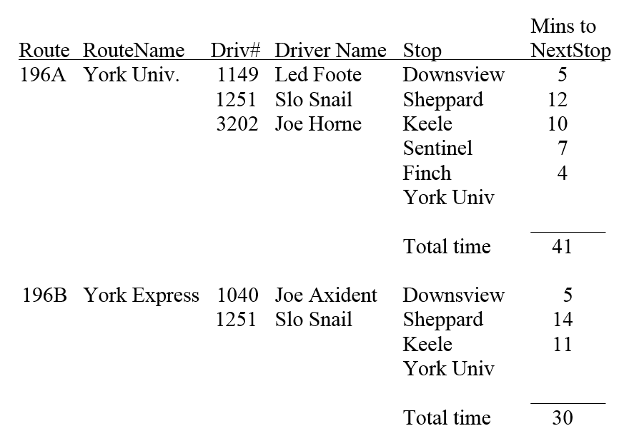
Route and Driver List

Slide 13
Route and Driver List
Notice that the time between stops depends on the route. The 196A takes 12 minutes to get from Sheppard to Keele, but the 196B takes 14 minutes. This is because more riders get on to the Express bus and an extra 2 minutes is needed for the time it takes for these extra riders to get on.

Slide 14
Route and Driver List
UNF: [Route# , RouteName, (Driver#, DriverName), (Stop, MinsToNextStop)]

Slide 15
1NF : Eliminate multi-valued dependencies.
First the DRIVER multi-valued dependency.
(Route#, RouteName) I.
(Route#,Driver#, DriverName) II.
Next, the STOP multi-valued dependency.
(Route#, Stop, MinsToNextStop) III.
So the tables in 1NF are:
[Route#, RouteName]
[Route#,Driver#, DriverName]
[Route#, Stop, MinsToNextStop]

Slide 16
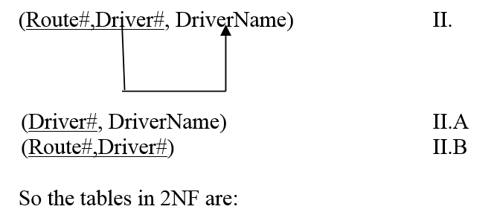
2NF: Eliminate Partial Dependencies
[Route#, RouteName]
[Driver#, DriverName]
[Route#,Driver#]
[Route#, Stop, MinsToNextStop]

Slide 17
3NF: There are no transitive dependencies, so the 3NF relations are:
ROUTE(Route#, RouteName)
DRIVER(Driver#, DriverName)
ROUTE-DRIVER(Route# (FK), Driver# (FK) )
DRIVING_TIME(Route#, Stop, MinsToNextStop)

Slide 18
2. Bridge Table for Many-to-Many Relationships
(with example of – non PK attributes on the Bridge Table)
The best way to physically represent a Many to Many Relationship between two entities is with a bridge table. The bridge table is between the two entities and has the primary keys of the two entities
(Example) A Company is owned by several Owners who own stock. But Owners can have stock in many companies. Thus COMPANY and OWNER are related as Many to Many.

Slide 19
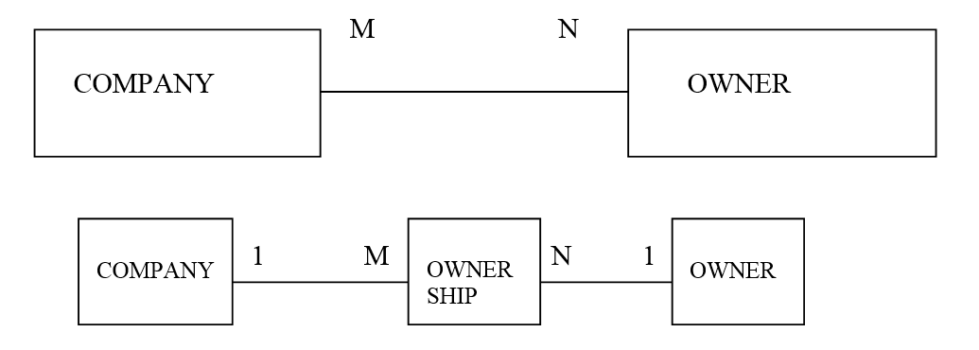
Many to Many Relationship

Slide 20
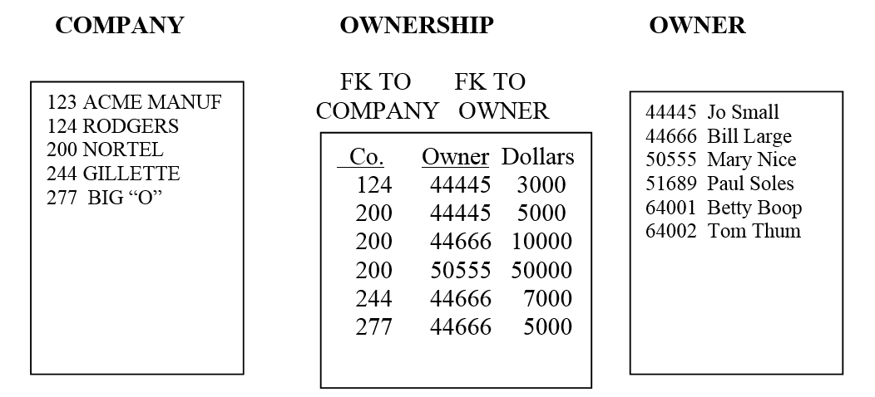
Many to Many Relationship
Let’s say that Joe small owns $5000 of NORTEL and $3000 of ROGERS. Bill owns $10000 NORTEL and $7000 of Gillette and $5000 of Big “O”. Mary has $50000 of NORTEL. The Ownership table (bridge table) has an entry for each.

Slide 21
Many to Many Relationship
Relations required for the M:N relationship between COMPANIES and OWNERs
I COMPANY(Co#, CoName)
II OWNERSHIP( Co# (FK), OwnerId (FK), DollarAmount)
This bridge table has more than just a PK!
III OWNER( OwnerID, OwnerName )

Slide 22
Next Week: “Merge”
Multiple Entity Sets --> Final Entity Set

